Slide 1
UCSF Office of Research Task Force on Equity and Anti-Racism in Research: Executive Summary to Final Report June 29, 2021
Dr. Monica McLemore
PhD, MPH, RN, FAAN
Dr. Tung Nguyen
MD

Slide 2
Background

Slide 3
Proposal & Guiding Principles
Group of 5
Malcolm John, MD, MPH
Monica McLemore, PhD, MPH, RN, FAAN
Tung Nguyen, MD
Jason Sello, PhD
George Taylor, DMD, MPH, DrPH
Community Engagement and Involvement
Faculty, Students, and Staff Participation
Compensation for anti-racism-related work
Reduce minority tax

Slide 4
UCSF Office of Research Task Force on Equity and Anti-Racism in Research
Task Force chartered to report to Executive Vice Chancellor and Provost
Develop recommendations for UCSF to implement with specific focus on anti-Black racism

Slide 6
Task Force Membership & Composition

Slide 7
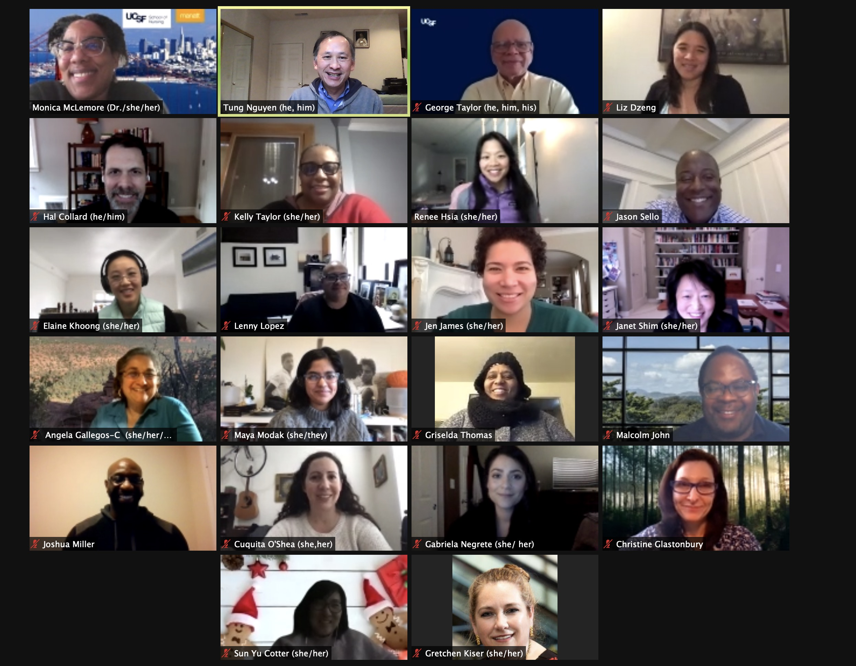

Slide 8
Methods

Slide 9
Methods
Biweekly Meetings & Agendas
Developing Recommendations
Community & Public Comment

Slide 10
Development of Recommendations
7 subgroups identified by themes
Partnerships & community engagement
Office of Research (RAP, CTSI, IRB)
People (Diversify research teams)
Developing Resources and Capacity
Precision Medicine
Anti-Racism in Research
RAP Grant Reviewer Process
Subgroups submitted recommendations
Organized & refined recommendations by themes for public comment

Slide 11
Community & Public Comment
Recommendations distributed widely across UCSF and beyond for 10-day public comment period
Subgroup for Public Comment duties included:
Categorize public comments/suggestions
Report findings to Task Force
Determine process to organize public comments/suggestions
Itemize/clarify needs by individual recommendation
Implementation suggestions/additional considerations
Suggestions for alterations/revisions
Comments that disagree
Laudatory comments
Integrate comments/suggestions to final recommendations

Slide 12
Task Force Accomplishments

Slide 13
6-Month Timeline
Dec 2020
Taskforce Established
Jan 2021
RAP Cycle
February 2021
Bi-weekly meetings for Recommendations
March 2021
Subgroup meetings
April 2021
Draft of Recommendations
May 2021
Recommendations to Public
June 2021
Recommendations Finalized

Slide 14
Accomplishment of Charter Activities
Office of Research Statement
RAP Cycle
Recommendations
Written and Sent from Lindsey Criswell
Establish Task Force
Inaugural Pilot Grants on Anti-Racism Research
Wide Range of Funders (up to $250K)
4 urgent topline recommendations
Themes of 164 distinct recommendations

Slide 15
URGENT TOP LINE RECOMMENDATIONS

Slide 16
I. Accountability: Establish accountability system for ongoing implementation & sustained progress on anti-racism and equity strategic goals for UCSF research

Slide 17
Permanent Leadership & Committee Structure
Appoint & support an Office of the Associate Vice Chancellor for Research Equity, Diversity, and Inclusion with joint appointment in Office of Research and Office of Diversity & Outreach
Convert Anti-Racism in Research Task Force into standing committee within Office of Research reporting to Associate Vice Chancellor for Research Equity, Diversity, and Inclusion
Create Advisory Board that engages diverse communities to set priorities, review grants, etc. to hold Office of Research accountable
Establish and support Black Health Center of Excellence with visible leadership of Black faculty and staff

Slide 18
Progress on Anti-Racism Goals in Research: Tracking Key Metrics
Create dashboards
Race-ethnicity of participants in clinical research studies
Race-ethnicity of research faculty, trainees, staff
Create metrics to assess salary equity, research space, research support
Include Lay Summaries in RAP grants for community-level review
Explore feasibility of creating tracking system to measure diversity of type of research
Evaluate and provide continual feedback for UCSF Leadership on their record and demonstrated commitment to DEI

Slide 19
II. Promote & support UCSF Anti-Racism Scholarship: Understanding & Uprooting Racial Hierarchies and their consequences

Slide 20
RAP Anti-Racism Research Program
Sustain & grow RAP anti-racism program
Commitment of funding (CTSI, Academic Senate, others)
Expand partnerships to institutional partners (Cancer Center, Preterm Birth Initiative, etc.) and UCSF-operated/affiliated health systems (UCSF Health, SFGH, etc.)
Advocate for anti-racism research pilot awards integrated into national network of CTSA programs
Establish and sustain oversight committee for RAP anti-racism research program

Slide 21
Revamp RFP Language and all Procedures
Standardize guidelines for definitions and use of racial categorizations and constructs in research proposals
Continue to iterate definition and essential criteria of anti-racism research in RAP RFPs
Develop formal guidelines to score anti-racism research proposals
Partner with and support community members in reviewing proposals and expand this model to other RAP programs (e.g. orientation and training, compensation)
RAP Anti-Racism Research Committee to oversee processes (RFP, scoring processes, etc.)
For all RAP programs:
Partner with and support community members on review committees
Integrate scoring criteria for equity and anti-racism

Slide 22
Amplify UCSF Anti-Racism Research Teams
Identify dedicated staff at UCSF Office of Communications for anti-racism and health equity research; support UCSF researchers for dissemination to internal/external audiences
Establish Chancellor’s Awards to honor leaders in Anti-Racism Scholarship
Recruit and partner with researchers skilled in critical race theory and social scientists

Slide 23
Anti-Racism Framework in Research
Strengthen capacity and competence for all UCSF researchers in anti-racism framework
CTSI consult service with focus on anti-racist constructs and methodologies in research
Expand CTSI Design & Implementation consultation to integrate qualitative human-centered research methodology
Create required course on “Racism in Research and Science” for all federally funded researchers with incentives
Create program in HRPP to educate IRB Committee members on anti-racist research principles and methods
Create and enforce equity and diversity standards for all human subjects research
Hire bi/multilingual and bicultural research teams to be more inclusive of non-English speaking participants

Slide 24
III. Diversify UCSF Research Workforce: Create & support more diverse academic, non-academic faculty researchers, trainees, and staff

Slide 25
Recruit, Support, Retain: Black & other URM Faculty
Strengthen and expand pathway programs for postdocs and fellows to become faculty
Provide funding for postdoctoral candidates for in-person interviews
Prioritize funding research packages for retention of URM faculty (e.g. housing assistance, financial advising services)
Prioritize recruitment of candidates who are alumni of HBCU, HSI, CSU, and community colleges
Sustain CTSI program to facilitate NIH Diversity Supplements

Slide 26
Recruit, Support, Retain: Black & other URM Faculty (cont.)
Prioritize recruitment of diverse mid to senior-level multidisciplinary faculty researchers and departmental leaders to develop research and institutional programs and mentor trainees
Create & fund positions in Offices of Deans/Department Chairs with key training opportunities for URM to create pathway programs for leadership positions

Slide 27
Revise Criteria for Advancement & Promotion of Faculty and Staff
Bolster importance and impact of Statement of Diversity section of advance CV; disseminate criteria for evaluation
Recognize co-author publications with community partners for academic advancement
For merit & promotion packets, include statement of community engagement or partnership
Weight community engagement similar to teaching, research, service, professional competence

Slide 28
Recruit Students of Color for PhD Training
Establish and fund programs to recruit Students of Color for PhD training
Expand summer research programs for undergraduates
Provide funds to address costs of relocating to SF Bay Area
Expand relationships with HBCU, colleges and universities with diverse populations

Slide 29
Diversify Research Teams
Sustain and expand SF BUILD Clinical Research Coordinators program to train HBCU, HSI, state and community college students and graduates for research-related jobs
Develop hiring program to train community members for research-related jobs
Empower research coordinators and research assistants as leaders in research projects
Track advancement and develop advancement opportunities for non-faculty research team members

Slide 30
Eliminate Minority Tax
Compensate BIPOC faculty, staff, students for anti-racism work
Compensate mentors through internal K24-like mechanisms to provide protected time to mentor URM trainees/trainees in disparities research
Compensate and add criteria for advancement for participation on committees, task forces, working groups, etc. from trainees to senior leadership

Slide 31
IV. Community Engaged Research: Foundational operating principle for anti-racism and equity research enterprise

Slide 32
More Resources for Community-Engaged Research Infrastructure
Create dedicated, sufficient, and sustained funding base for community engagement activities at UCSF for long-term and non-transactional relationships based on funding
Funding of community engagement costs to support community-led/community-engaged research in Chancellor’s funds, Academic Senate funds, etc.
Requirement for community representatives with adequate compensation on research projects
Create ongoing campus-wide funding mechanisms for bridge funding of community engaged work
Establish University-wide “minimum wage” for all community members who participate in community engagement activities (e.g. speakers, educators)

Slide 33
Support & Recognize Community Research Partners
Create Community Faculty designation for community research partner leaders
Create Watson Scholar equivalent for community partners
Provide funding for academic conferences for community research partners to present jointly with UCSF partners

Slide 34
Accountability System: Progress on anti-racism and equity strategic goals
Systematically elicit community input on research priorities and provide resources (access to UCSF researchers) to address priorities and other community needs
Create UCSF Partnership Course for researchers and community partners
Scale up dissemination and use of community-engaged research resources and toolkits

Slide 35
Next Steps & Moving Forward

Slide 36
Next Steps
Resources
Humans, Money, Space, and Time
Final report submitted to UCSF Leadership
Anti-Racism Task Force on Research to continue

Slide 37
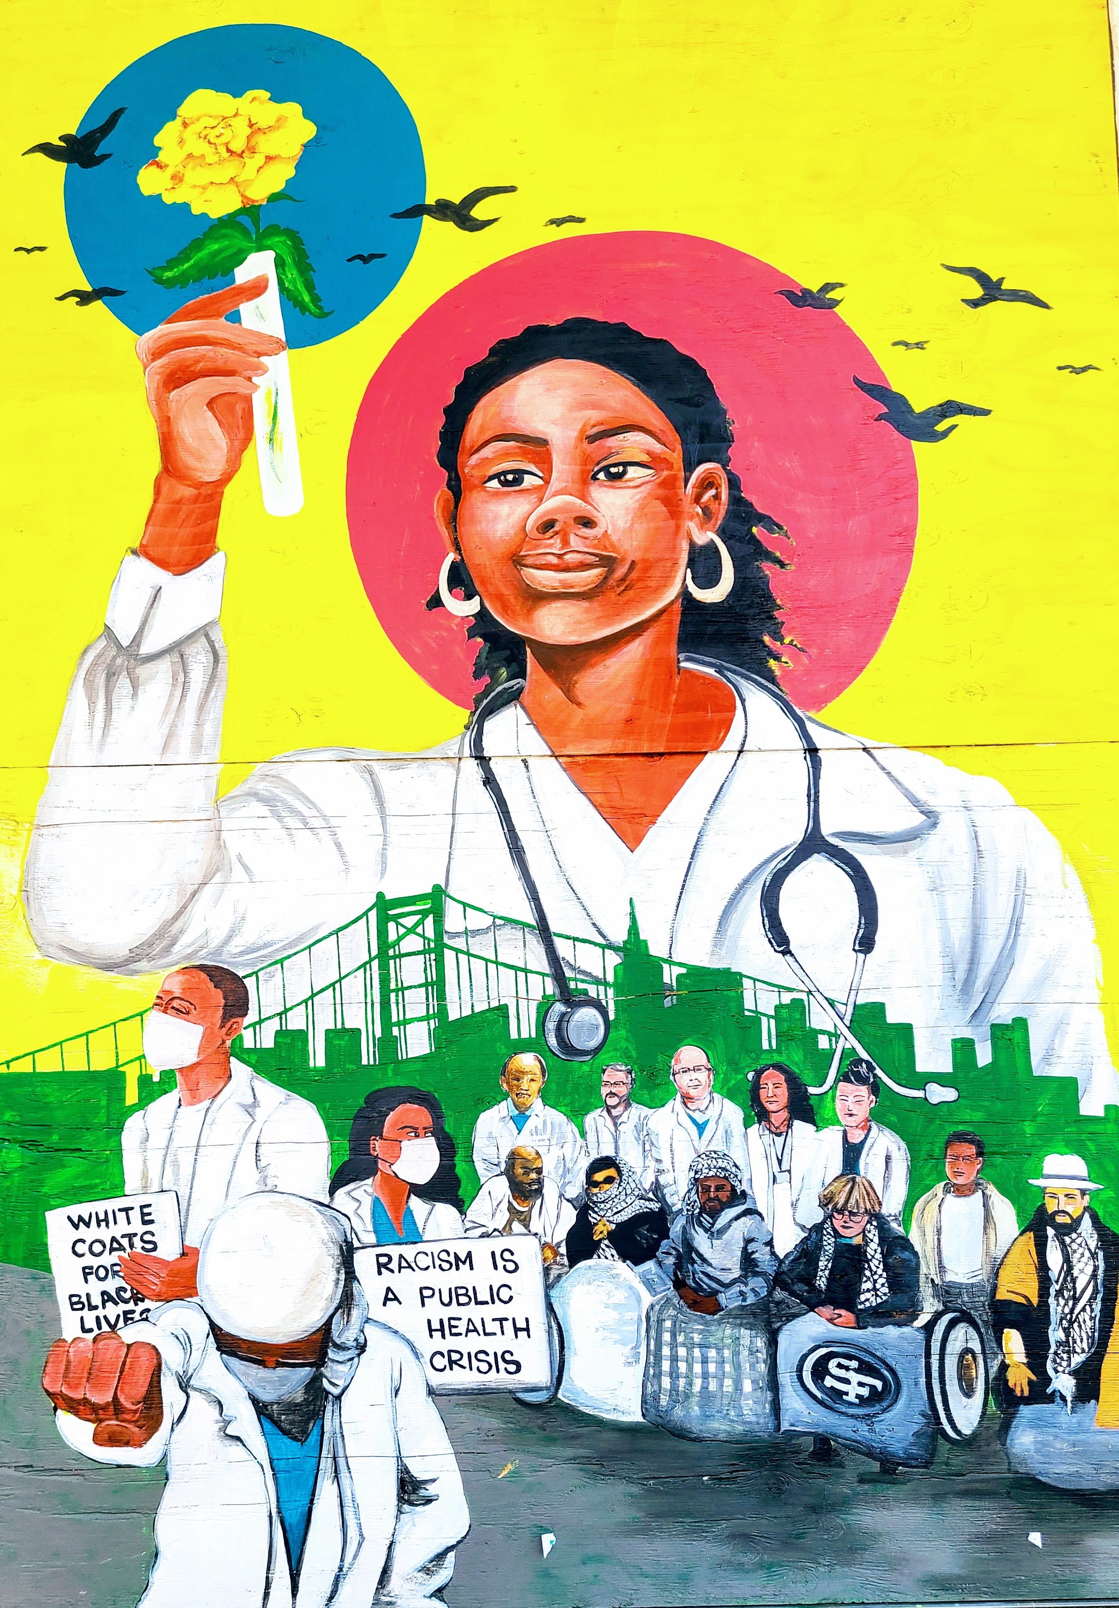
Thank you

